Slide 1
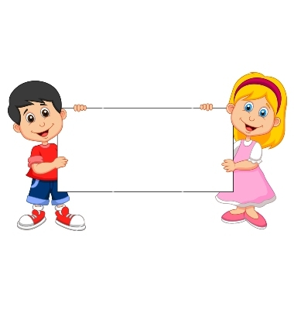


Donation
(Unable Piggybank)

Slide 2
Girls Version
Familiarization Task

Slide 3
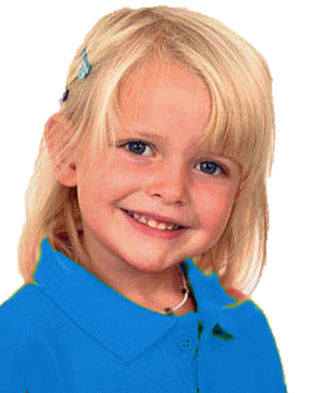
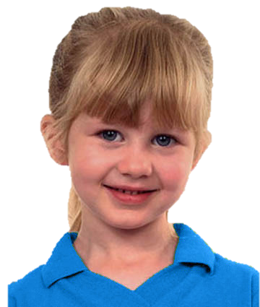
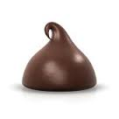
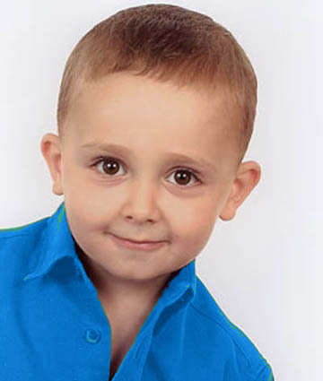
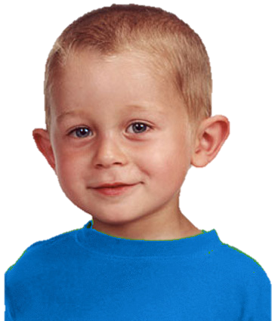
Introduce the group & the piggybank

Slide 4
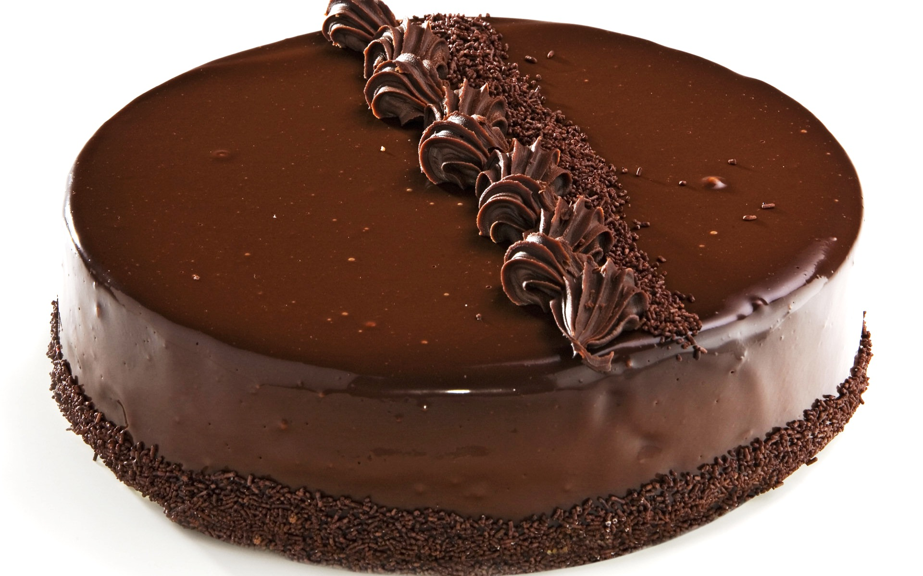
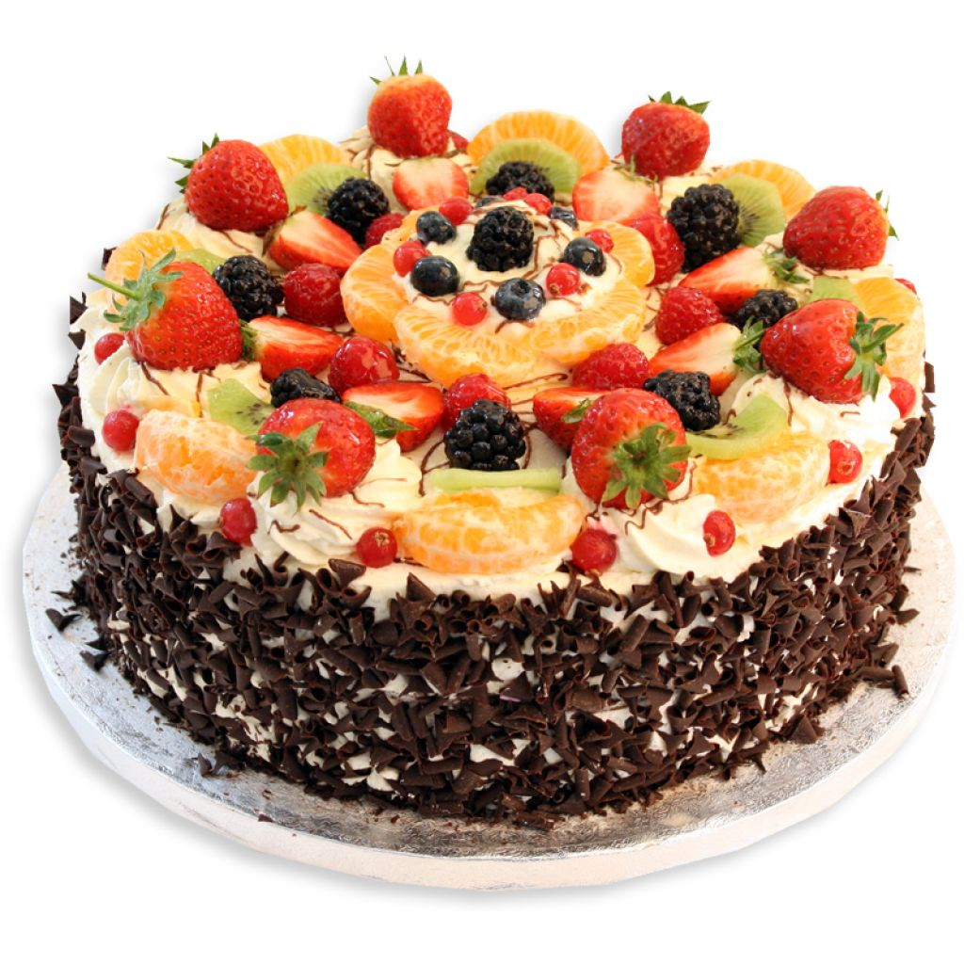
Explain how the piggybank works

Slide 5
Questions & feedback

Slide 6
Test Task

Slide 7
The group goal: have a big cake and share it

Slide 8
Unable free-rider (upper left):
She wants to put her chocolate in the piggybank. But a puppy comes and eats her chocolate. The other kids put their chocolate in the piggybank.

Slide 9
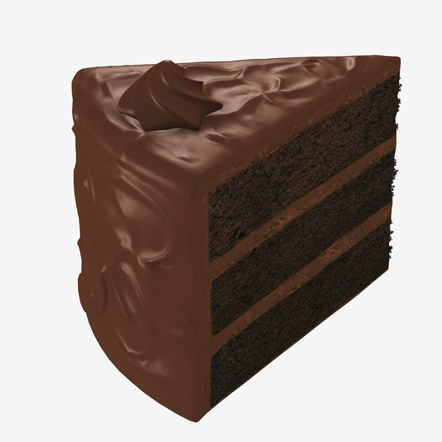
The outcome
The outcome: The piggy bank makes a small cake. Each kid gets a piece of it.

Slide 10
Test Questions
F
C

Slide 11
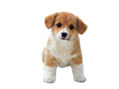
Unable Free-Rider Reminder:
She wanted to put her chocolate in the piggybank. But a puppy came and ate her chocolate. The other kids put their chocolate in the piggybank.

Slide 12

Evaluation: is she good or bad?

Slide 13
Evaluation: a little good/bad or really good/bad?

Slide 14


Preference: Do you like her or you don’t like her?

Slide 15


Preference: do you like her a little or a lot? do you kind of don’t like her or really don’t like her?
To Contributor

Slide 16
Contributor Reminder:
Wanted to put her chocolate into the piggybank and put it there.

Slide 17
Evaluation: is she good or bad?

Slide 18
Evaluation: a little good/bad or really good/bad?

Slide 19
Preference: Do you like her or you don’t like her?

Slide 20
Preference: do you like her a little or a lot? do you kind of don’t like her or really don’t like her?
To Free-Rider

Slide 21
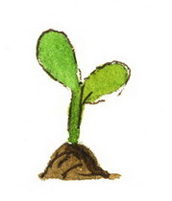
Donation
(Unwilling Plant)

Slide 22
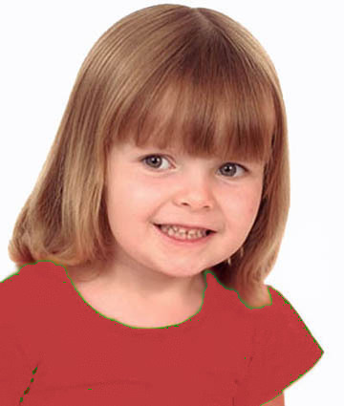
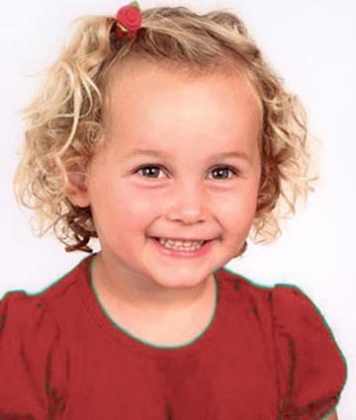
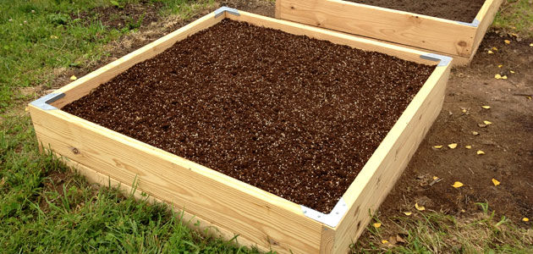
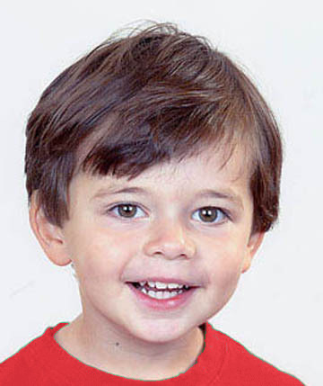
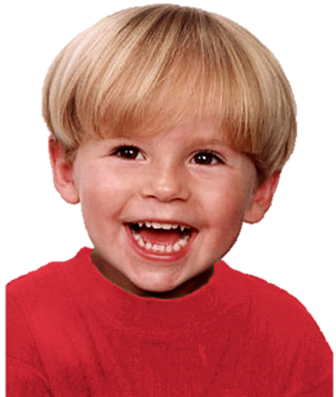
Introduce the group & the garden

Slide 23
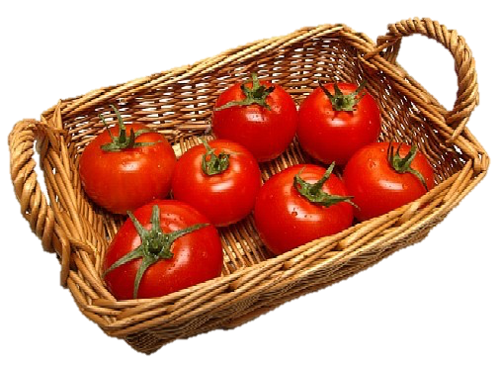
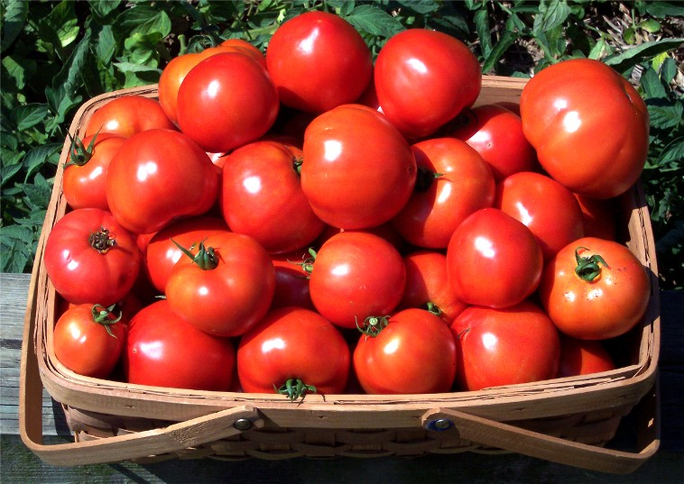
Explain how the garden works

Slide 24
Questions & Feedback

Slide 25
Test Task

Slide 26
The group goal: have a big basket of tomatoes and share them

Slide 27
She doesn’t want to put her plant in the garden. So she plants her at home. The other kids put theirs in the garden.
Notes:
The boy (on the upper right corner) wants to put his plant in the group garden,
but a rabbit comes to eat his plant

Slide 28
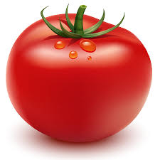
The outcome: They get a small basket of tomatoes. Each kid gets a tomato.

Slide 29
Test Questions
F
C

Slide 30
Test Questions
Free-rider

Slide 31
Unwilling Free-Rider Reminder:
She didn’t want to put her plant in the garden. So she planted hers at home. The other kids put theirs in the garden.

Slide 32
Evaluation: is she good or bad?

Slide 33
Evaluation: a little good/bad or really good/bad?

Slide 34
Preference: Do you like her or you don’t like her?

Slide 35
Preference: do you like her a little or a lot? do you kind of don’t like her or really don’t like her?
To Contributor

Slide 36
Contributor Reminder:
Wanted to put her plant in the garden and put it there.

Slide 37
Evaluation: is she good or bad?

Slide 38
Evaluation: a little good/bad or really good/bad?

Slide 39
Preference: Do you like her or you don’t like her?

Slide 40
Preference: do you like her a little or a lot? do you kind of don’t like her or really don’t like her?
To Free-Rider

